Slide 1
MACHINE LEARNING PROJECT RESUME CLASSIFICATION

Slide 2
GROUP - 6

Slide 3
BUSINESS PROBLEM :
OBJECTIVE:
The document classification solution should significantly reduce the manual human effort in the HRM .It should achieve a higher level of accuracy and automation with minimal human intervention.

Slide 4
PROJECT STATEMENT
This dataset consists of about Resume Details which is been classified on basis of 4 categories.
Aim of this project is to check whether a candidate is qualified for a role based his or her education, experience, and other information captured on their resume.
In a nutshell, it's a form of pattern matching between a job's requirements and the qualifications of a candidate based on their resume . Also it consists of 2 columns namely Raw Details and Category .

Slide 5
LIBRARIES USED
Pandas
NumPy
Matplotlib
Seaborn
NLTK
NumPy
Matplotlib
Seaborn
NLTK
Stop words
Word Cloud
RE
Job lib
sk learn
Then, Read the Dataset

Slide 6
PROJECT SECTION
Exploratory Data Analysis (EDA)

Slide 7
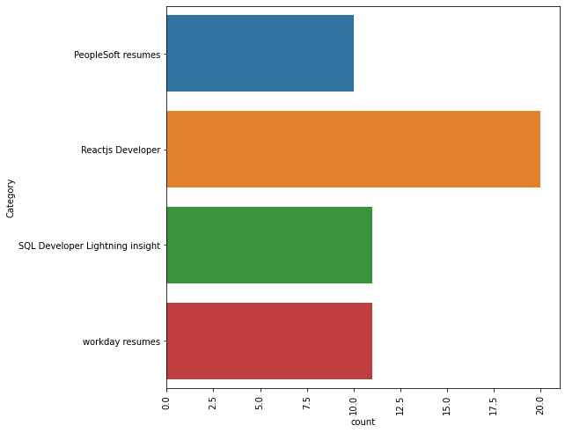
RESUME BASED ON CATEGORY
It’s a Count plot based on Resume which is further divided into four categories wherein most resumes belongs to Reacts Developer Category.

Slide 8
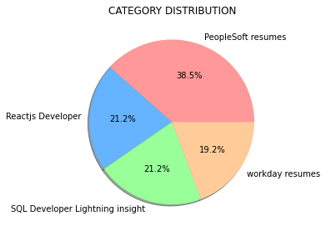
RESUME BASED ON CATEGORY
It clearly shows that most of the of the Resumes belong to PeopleSoft Resume in the given dataset.

Slide 9
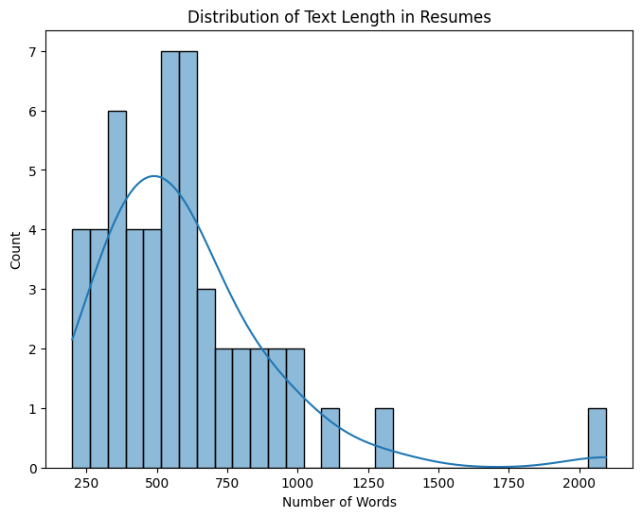
'DISTRIBUTION OF TEXT LENGTH IN RESUMES
The maximum number of words contained / distributed in the resumes mostly lies between 500-700 words.

Slide 10
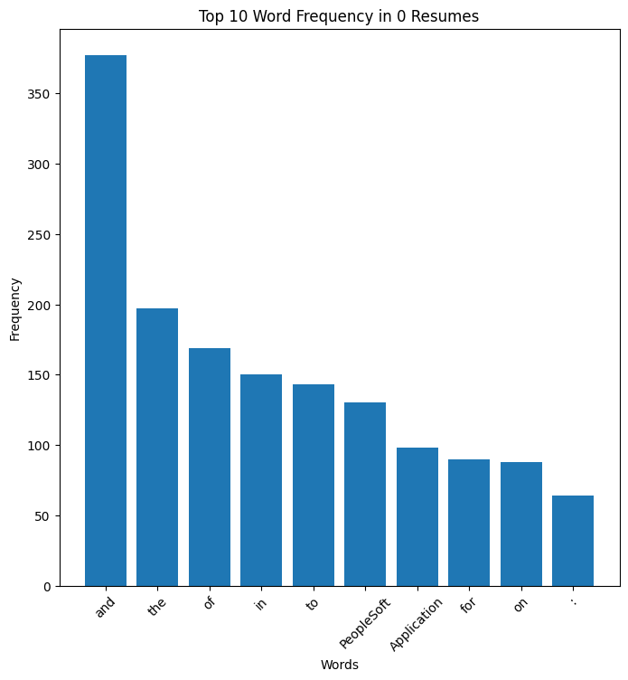
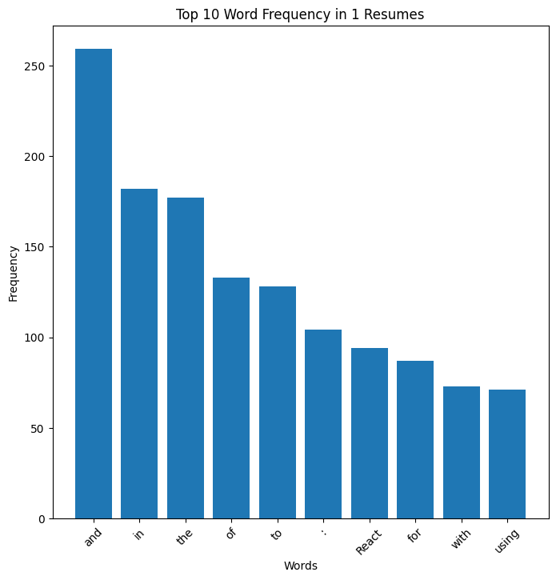
TOP 10 WORDS BASED ON CATEGORY
This histogram shows distribution of Top 10 words in different in Resume based on the 4 different categories.
It Concludes that and is the most frequent word in all the four categories of resume.

Slide 11
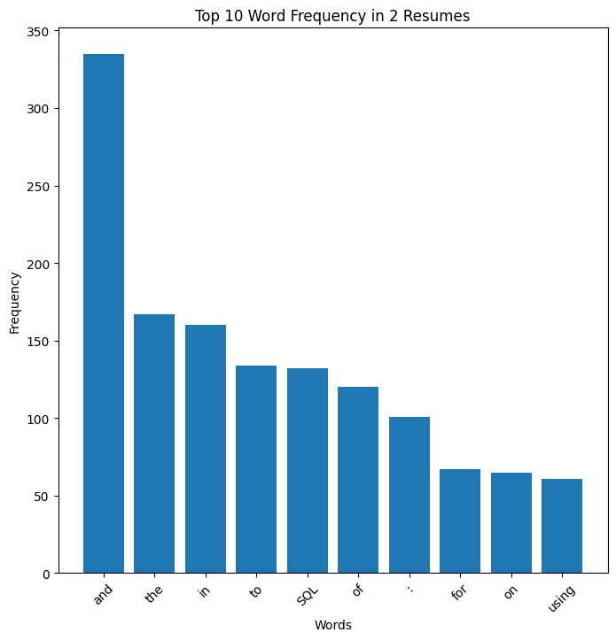
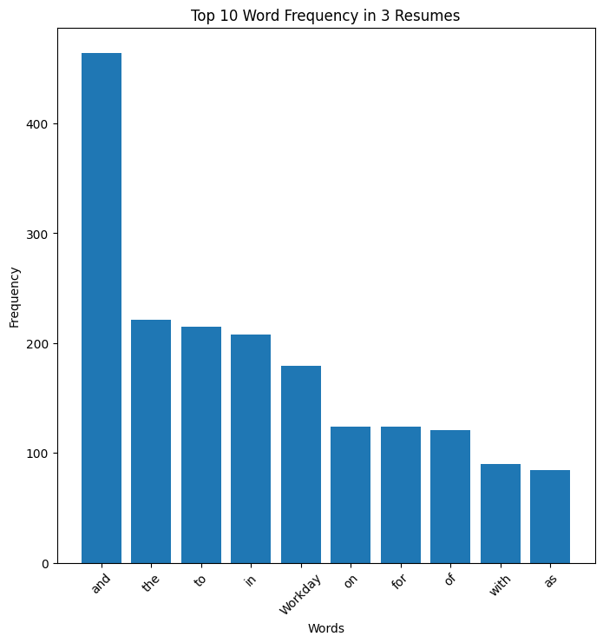

Slide 12
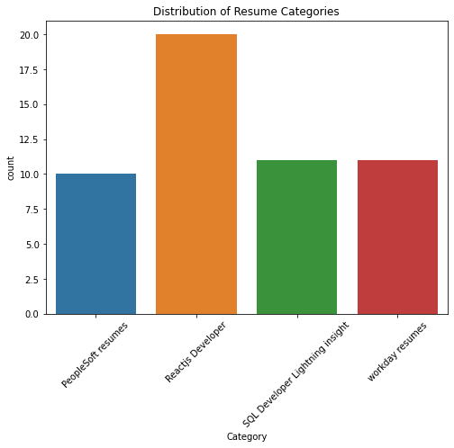
VISUALIZE BALANCING OF RESUMES BASED ON CATEGORIES
Distribution resumes based on 4 different Resume Categories.

Slide 13
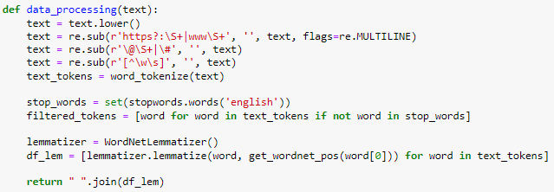
Text Processing
Helps to convert all text to lowercase
Regular Expression helps to remove 'https', 'www‘ unwanted URLs from the text
Regular Expression helps to remove unwanted symbols and hashtags
Regular Expression helps to remove unwanted punctuations
Tokenization helps to split words into individual words
This will join the filtered text in to a single string

Slide 14
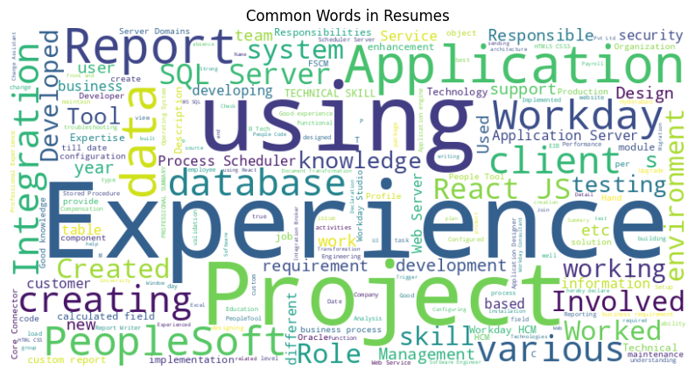
VISUALIZE FREQUENTLY USED WORDS IN RESUME TEXT
This Word cloud shows, which are the most frequently used words available in Resume texts.
As we can see, Experience, Using , Project, Application are the most frequently used words.

Slide 15
PROJECT SECTION
Model Building

Slide 16
MODELS USED
We trained our dataset using different classification methods, as mentioned below
Logistic Regression
Random Forest
100%
100%
Naïve Bayes
XGBoost
K-Nearest Neighbours
Support vector machine
100%
95%
100%
97%

Slide 17
SUPPORT VECTOR MACHINE CLASSIFIER
Accuracy – 100%
Support vector machine
100%

Slide 18
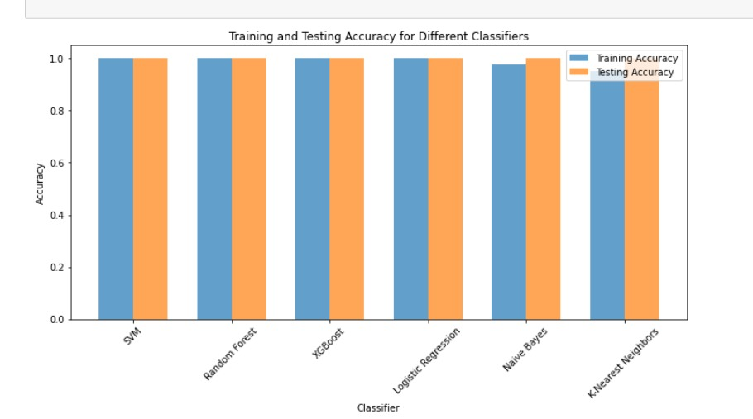
ACCURACY
This bar plot shows accuracy of all models in one frame
As we can see in the graph Support vector machine classifier gives the highest accuracy
Hence, Support Vector Machine will be our finalized model to move further with our manual testing.

Slide 19
MODEL EVALUATION
From the cross validation table ,it is clear that SVM Model has the highest Cross validation scores .
Hence we have considered SVM as the final model for deployment
MODEL NAME | CROSS VALIDATION SCORES
SVM Cross-Validation Scores | 95%
Random Forest Cross-Validation Scores | 90%
XGBoost Cross-Validation Scores | 85%
Logistic Regression Cross-Validation Scores | 91%
Naive-Bayes Cross-Validation Scores | 78%
K-Nearest Neighbours Cross-Validation Scores | 91%

Slide 20
MODEL DEPLOYMENT

Slide 21

WEBPAGE
This is how the page of our deployment webpage looks like
Here we have to upload one or more resumes.
Once Resumes files are entered press Classify button to view the results.

Slide 22

FINAL WEBPAGE TO PREDICT

Slide 23
CHALLENGES FACED
Getting words in to its base format
Downloading the dataset zip, unzip of data.
System Slowness / compatibility Issue
Waiting long time for hyper parameter tuning
Decide which graph to use for visualization

Slide 24
HOW DID WE OVERCOME CHALLENGES FACED
Earlier we decided to use port stemmer which will help us to convert all the words in to its base format however when we executed the function then the results were not that good what was required, later we did some research and decided to go with lemmatization and yes the results came out to be good.
When we started executing our functions, normal functions were executing very fast however when it comes to visualization or any kind of long function it used to take very long to execute, then we as a group used to get on call and request everyone to execute the same code in their system and check which one gets executed fast and that is how we overcome this problem
As said earlier, the longest function used to take very long, and it was the same story when it comes to hyper parameter tuning, when we tried executing the function it took so long to execute and we had no option than waiting for it to execute
At the start of this project during EDA section when we have been requested to add more graphs to get more insights about dataset, it was little difficult to chose which graph to add however we did some research with the help of google and able to visualize our dataset.

Slide 25
OUR TEAM
Sarth Naik
Shivam Jaiswal
Vidya Reddy
Bindhu B N

Slide 26
THANK YOU

